Slide 2
Welcome to the new PowerPoint
for
TATA Trust i5 Pioneer Prize
Husayn Saifee | Oshin Goel | Raghav Palriwala | Vivek Kumar

Slide 3
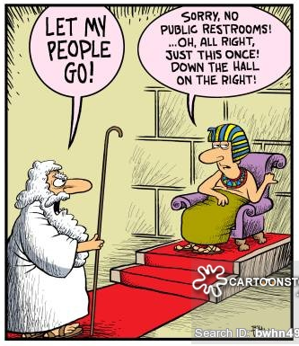
Introductory slide
Challenge
lack of clean, hygienic public washroom systems
Affordable and easy to maintain public urinal systems aimed at eradication of communicable diseases caused due to breeding of mosquitoes and insects in the public areas frequently subjected to open urination.

Slide 4
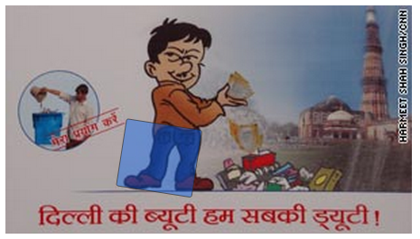
Sign in section
“public urination is a common sight across India”

Slide 5

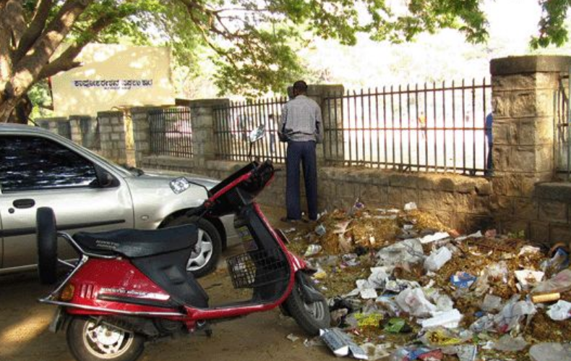
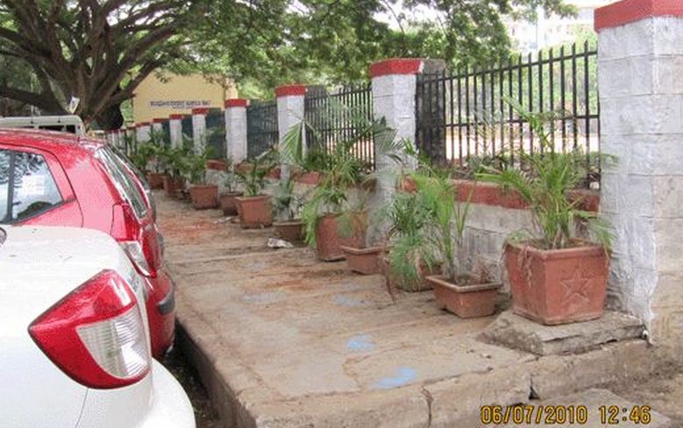
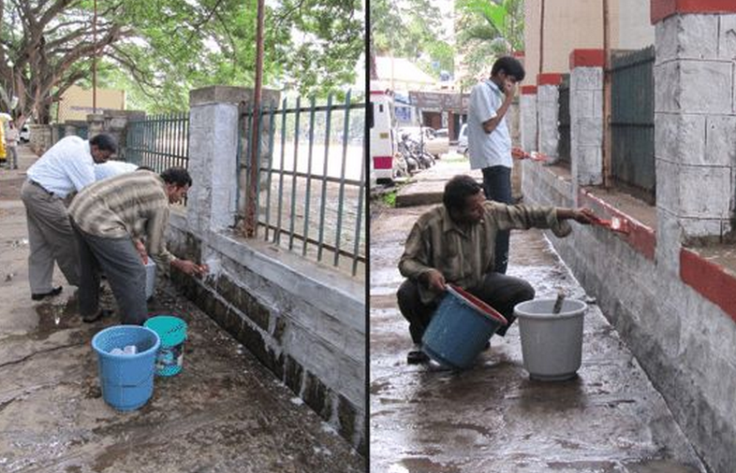
Sign in section
Pick up the ‘Aam Aadmi Jhadoo’

Slide 6
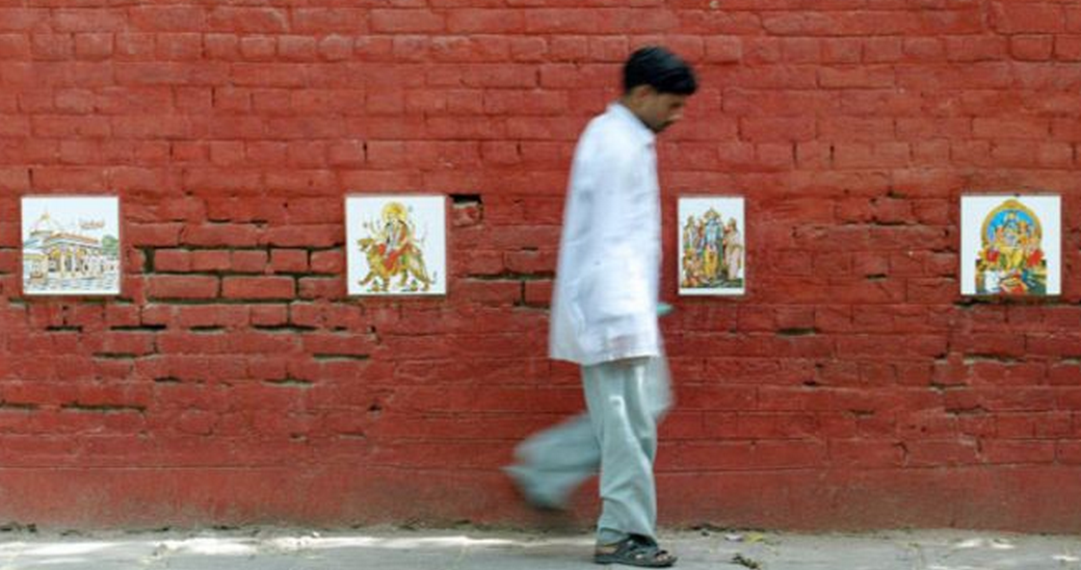
Sign in section
People fear the wrath of God (especially when their pants are down).

Slide 7

Sign in section
Public humiliation for public urination

Slide 8
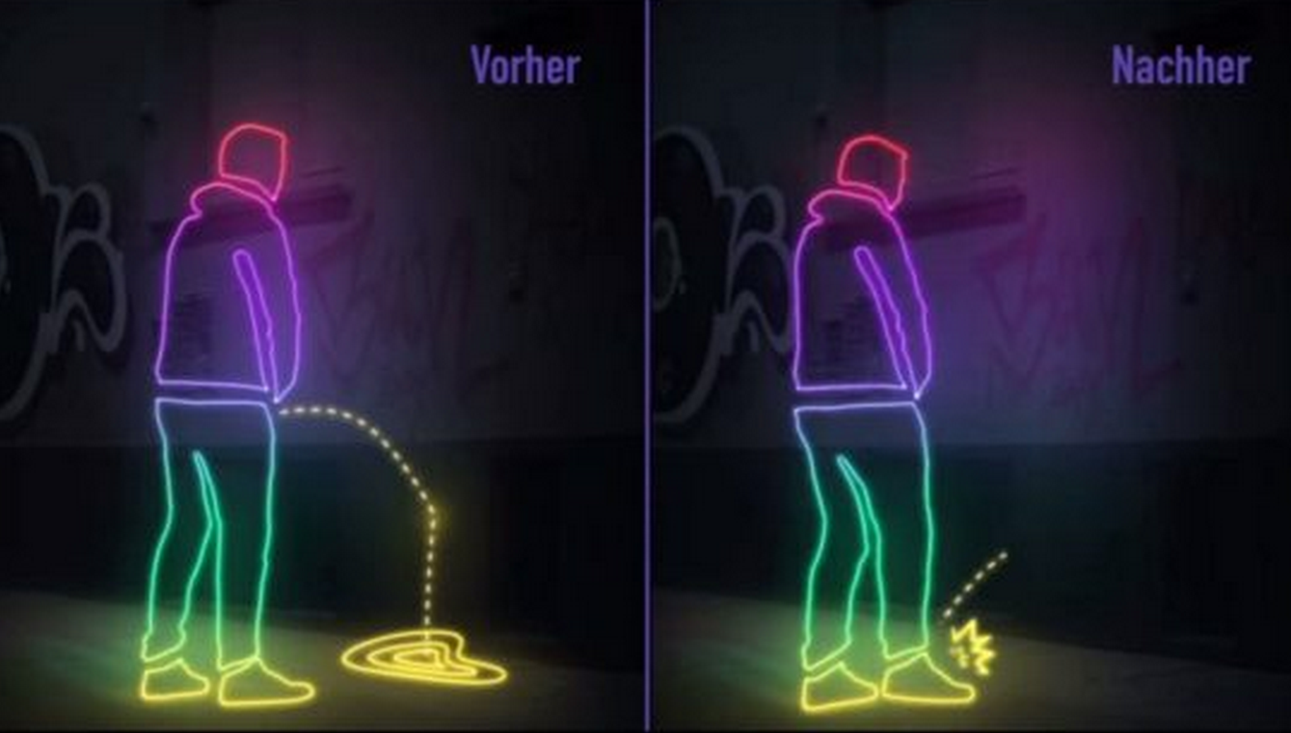
Sign in section
Public humiliation for public urination

Slide 9
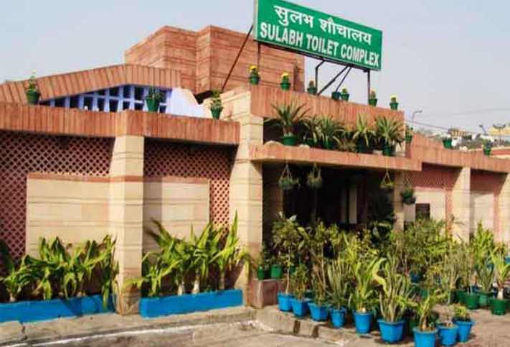
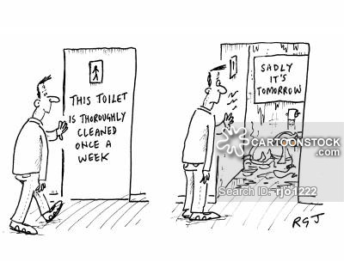

Sign in section
Built Infrastructure

Slide 10



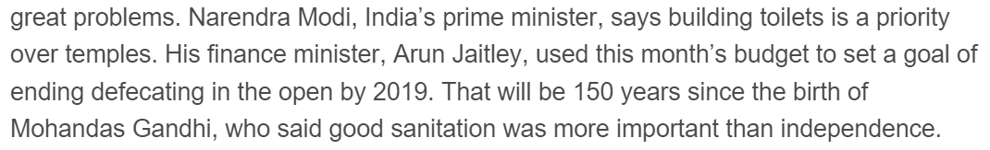
Microsoft account explanation
The Debate

Slide 11
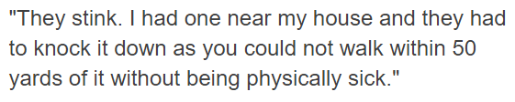
Microsoft account explanation
Maintenance and Corruption
In several places, toilets have been taken over by the local thug or moneylender who charges whatever he pleases and virtually makes the toilet his adda.

Slide 12
Conclusion slide
Solution
Affordable to fabricate and install
Scalable: Mobile and compact yet durable product
Self-sufficient revenue model to furnish maintenance costs
Hygienic: Eliminates the problems of stinking and eyesore
Sanitized: eliminates breeding grounds for mosquitoes and insects
Eco-friendly: Helps in increasing green cover in urban centers
Free to use for all

Slide 13
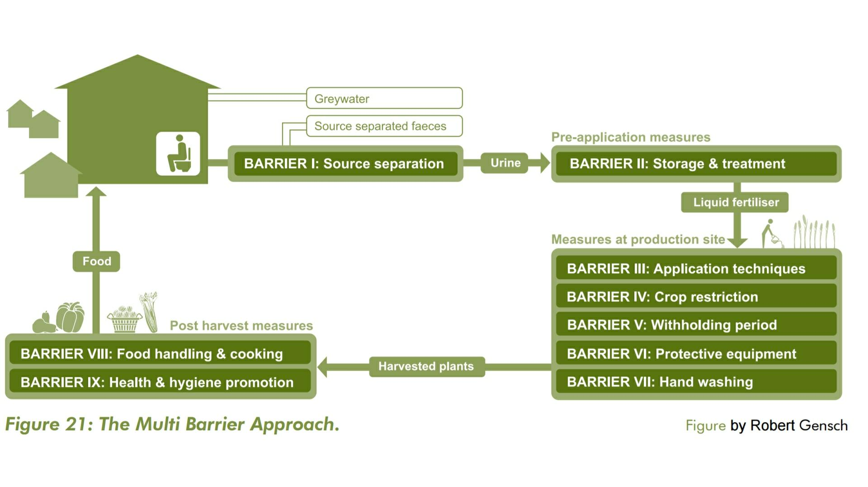
Technology: Urine Fertilization
Urine is a well-balanced nitrogen-rich quick-acting liquid fertilizer.
Urine contains the highest levels of nutrients among all the human excreta and yields considerable amounts of nitrogen, phosphorus and potassium. These are the most essential nutrients for the growth of plants, and substantially all micronutrients
Collection system for urine is designed to eliminate the risk of faecal cross-contamination.
Notes:
https://www.laboratoryequipment.com/news/2014/08/urine-could-be-effective-fertilizer
http://www.ecosanres.org/publications.htm#2010-1:_Practical_Guidance_on_the_Use_of_Urine_in_Crop_Production_by_Anna_Richert,_Robert_Gensch,_Håkan_Jönsson,_Thor-Axel_Stenström_and_Linus_Dagerskog.

Slide 14
Sustainability: Business Model
Economic Value of Urine: Rs 600 Per person per year
Urban male population: 19,58,07,196
400 m2 x 19,58,07,196 = 78,322,878,400 m2
862000 km2 vs 78322km2 = 10% land area
Rs 117,484,317,600 or USD 1,841,164,882 ($1.8 bn)
Advertisement space
20000 per sqkm density in top urban centers
1 per 1000 men = 10 urinals per sqkm
30 sqft ad space per urinal
195807 urinals x 100 sqft x rs 50 x12 monthspersqft
INR 11,748,420,000 or USD 184,116,232 ($184 mn)

Slide 15
How Office remembers you
Ground Testing
Data Analytics
Lab Testing
Prototype
road ahead…

Slide 16
Conclusion slide
That’s it
Thanks for listening!

